Slide 1

Project 3: Healthcare Expenditures data, Design, Delivery Overview
Group: Andrew Amato
Steph Chestnut
Kyle Keegan
Gerardo Rodriguez
Brianna Trigueros-Pericone

Slide 2
Data
The data was pulled from two sites:
US Centers for Medicare and Medicaid Services (2024). Health Expenditures by State of Residence: Summary Tables [Data set]. CMS.gov. https://www.cms.gov/data-research/statistics-trends-and-reports/national health-expenditure-data/state-residence
St. Louis Fred Economic Data (2024). Income Per Capita Consumption Expenditures by State. [Data Set]. Fred.stlouisfed.org. https://fred.stlouisfed.org/release/tables?rid=391&eid=217586

Slide 3
Overview
Group 3 will be using data sets from the US Centers for Medicare and Medicaid Services and the St. Louis Fred and will look at healthcare consumption by state investigating the correlation between private healthcare usage, income, and region. We will also be taking a deeper dive into healthcare usage to include patient usage of physicians, clinics, and hospitals. State consumption rates can also vary based on time frame and we will examine this correlation between 2010-2020.

Slide 4
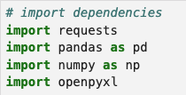
Data transformation
The data was captured in two formats: JSON and XLS.
The data was fed to a Jupyter NB where it was read using the following dependencies to clean the data: requests, pandas, numpy, openpyxl

Slide 5
Data transformation
Drop rows and columns
Sort values
Change datatypes from (FLOAT to INT)
Convert xls files to csv

Slide 6
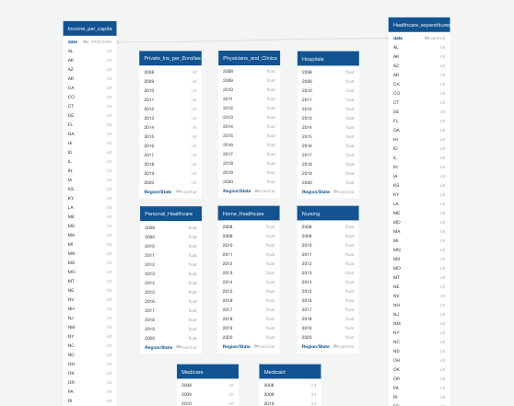
DATABASE
Used an ERD Schema to create tables
Housed the data we imported in SQL / Postgres
Then created unique datasets by combining this data

Slide 7
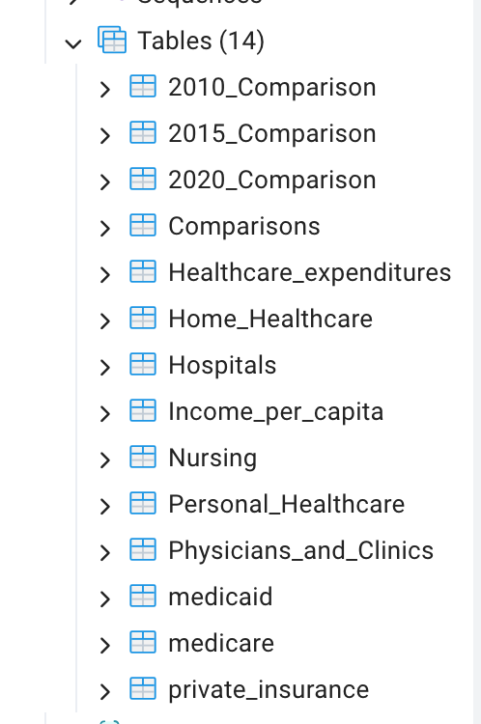
DATABASE and design
We used SQL because we were able to house the data in visible database where it can be analyzed and manipulated to examine relationships.

Slide 8
Additional Libraries
Openpyxl – used perform tasks on excel data.
Psycopg2 – Uses python code to connect to PostgresQL.

Slide 9
Data delivery
This project used combined datasets designed in SQL and delivered via SQLalchemy, Pandas and Flask showing visualizations that represent our analysis topics.

Slide 10
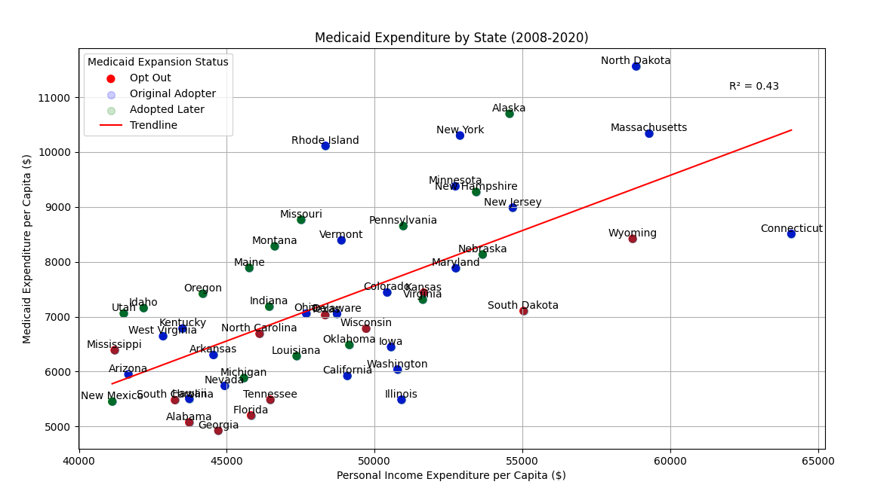


Slide 11
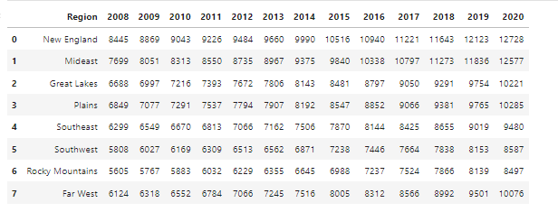
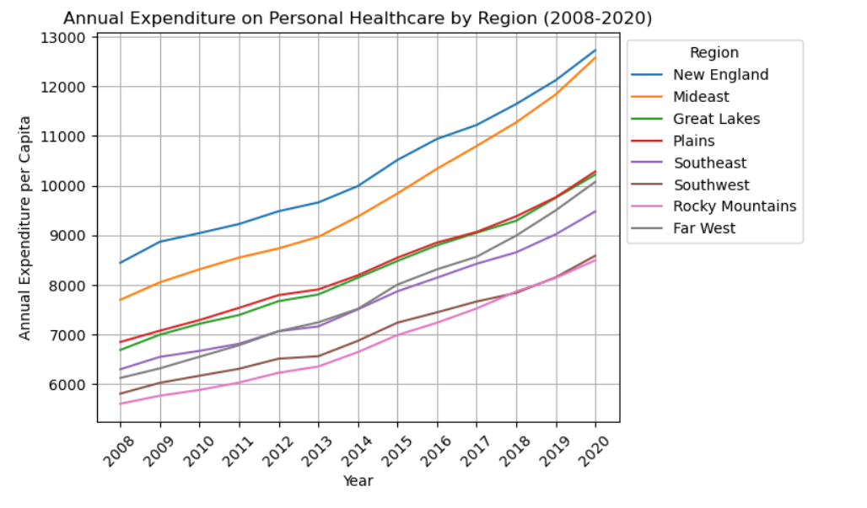
Annual Expenditure on Personal HealthCare
As seen from the chart, all regions continue to increase their spending on Personal Healthcare each year.
The New England and Mideast regions are spending the most, with the Rocky Mountains and Southwest spending the least

Slide 12
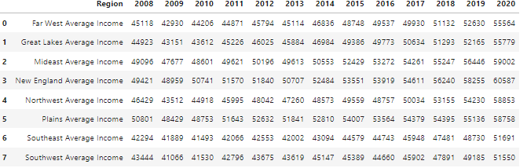
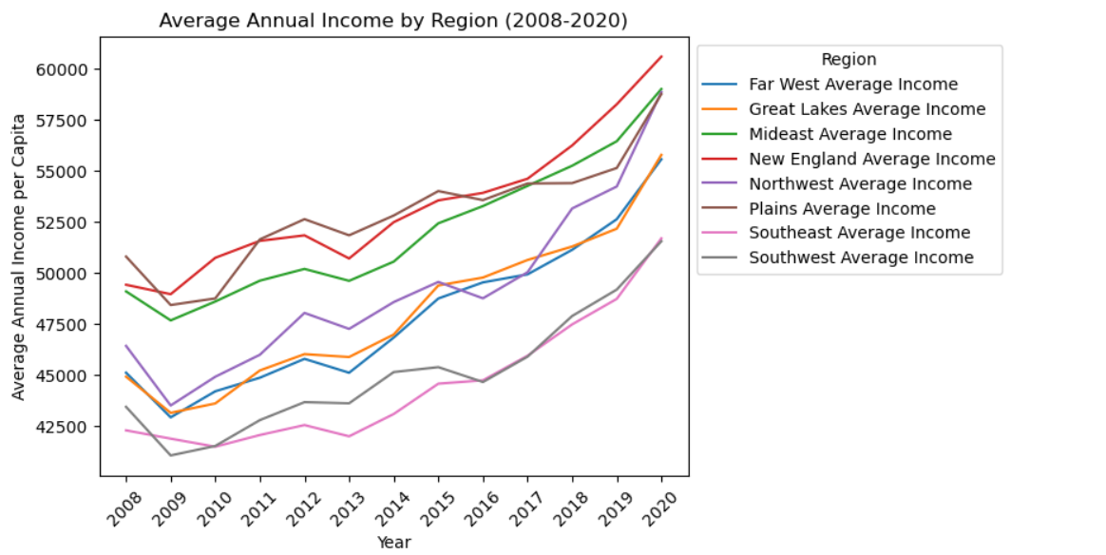
Annual Income by Region
The annual income of each of the regions has continued to increase, but not as consistently as the expenditures on personal health care.

Slide 13
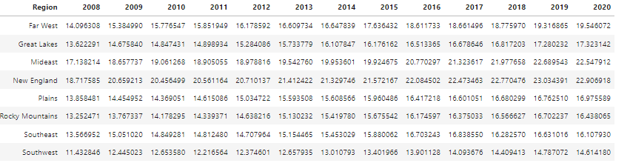
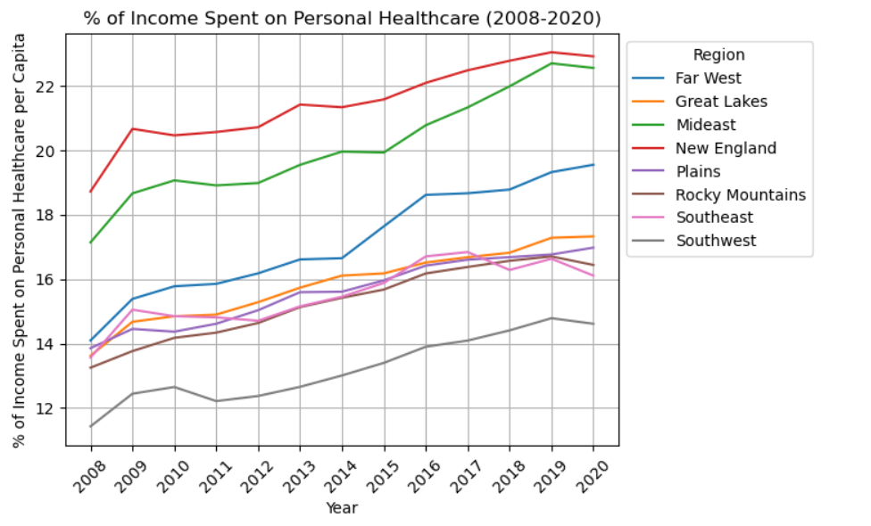
Annual Expenditure on Personal HealthCare
We then calculate the percentage of the annual income that was being spent on personal healthcare.
New England and Mideast spent the highest percentage of their income on personal healthcare, while the Southwest spent the lowest

Slide 14
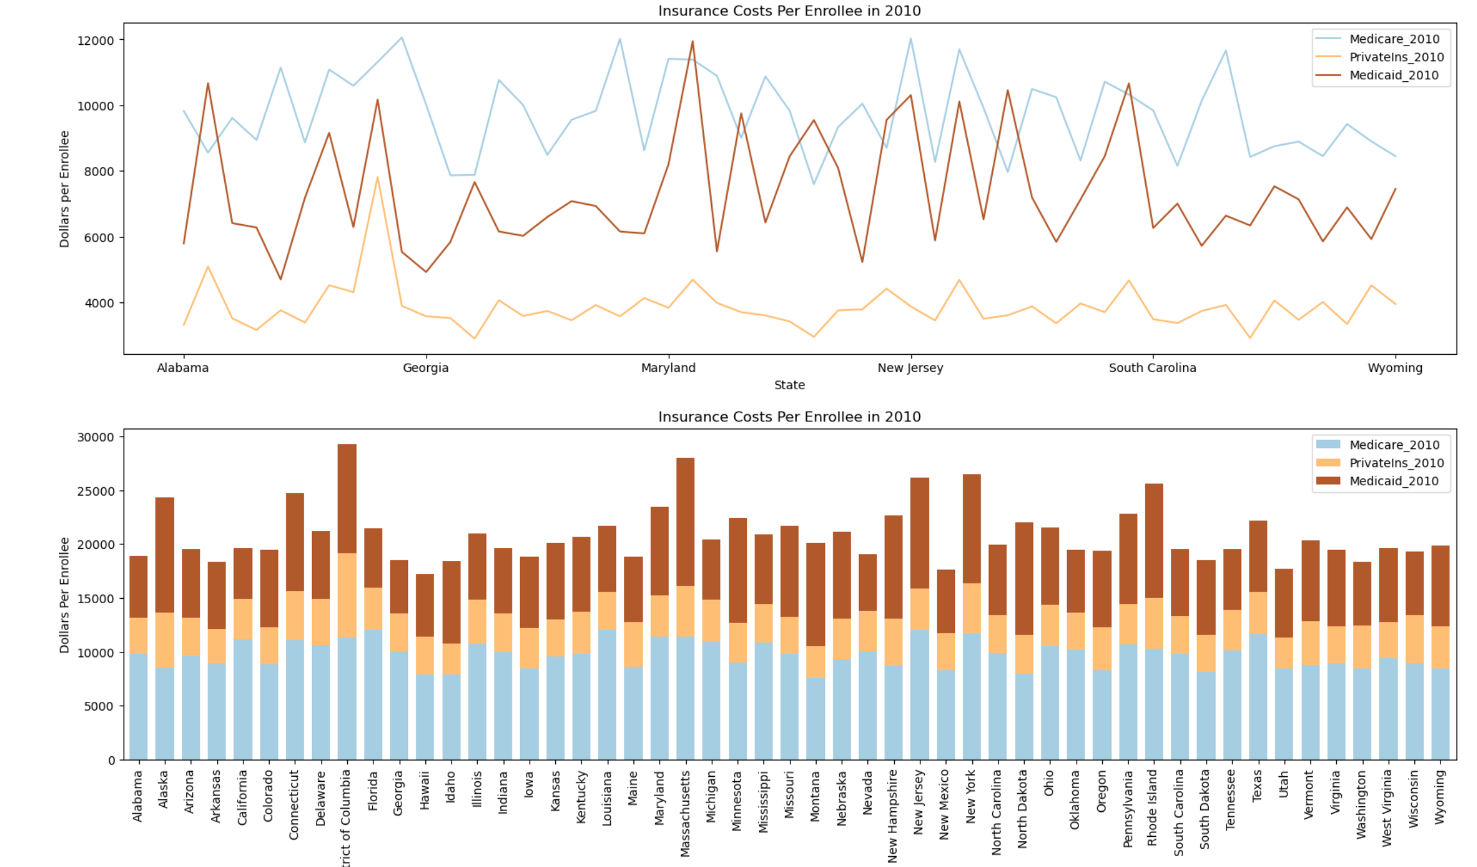
Comparisons Medicare/private/Medicaid

Slide 15
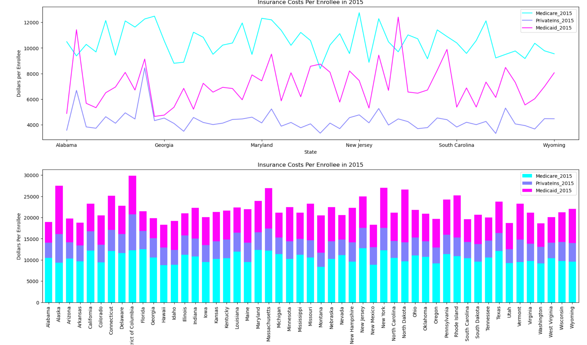
Comparisons Medicare/private/Medicaid

Slide 16
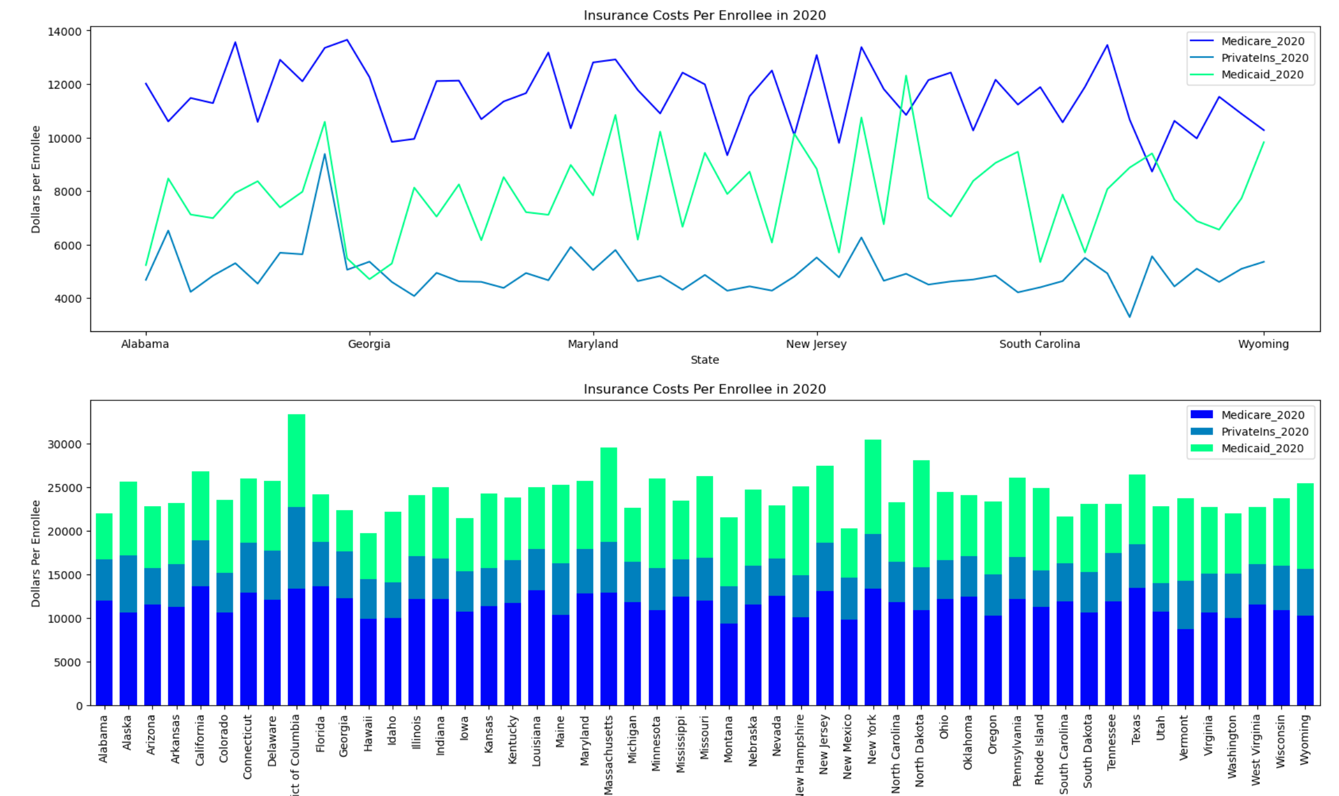
Comparisons Medicare/private/Medicaid

